Slide 1

Agile Software Development (TCS 855)
Unit-II Agile Project Management
Agile Scrum Methodology contd…
Prof.(Dr.) Santosh Kumar
Department of Computer Science and Engineering
Graphic Era Deemed to be University, Dehradun

Slide 2
Implement The Implement phase consists of following three processes.
Create Deliverables - In this process, the Scrum Team works on the tasks in the Sprint Backlog to create Sprint Deliverables. A Scrumboard is often used to track the work and activities being carried out. Issues or problems being faced by the Scrum Team could be updated in an Impediment Log.
Conduct Daily Standup - In this process, everyday a highly focused, Time-boxed meeting is conducted referred to as the Daily Standup Meeting. This is the forum for the Scrum Team to update each other on their progress and any impediments they may be facing.
Groom Prioritized Product Backlog - In this process, the Prioritized Product Backlog is continuously updated and maintained. A Prioritized Product Backlog Review Meeting may be held, in which any changes or updates to the backlog are discussed and incorporated into the Prioritized Product Backlog as appropriate.

Slide 3
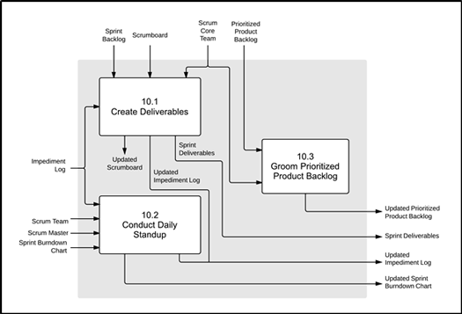
Following is the data flow diagram of the Implement phase, broadly showing how different processes are connected to each other. For more details on different processes.

Slide 4
Review and Retrospect
The Review and Retrospect phase consists of following three processes.
Convene Scrum of Scrums - In this process, Scrum Team representatives convene for Scrum of Scrums (SoS) Meetings in predetermined intervals or whenever required to collaborate and track their respective progress, impediments, and dependencies across teams. This is relevant only for large projects where multiple Scrum Teams are involved.
Demonstrate and Validate Sprint -In this process, the Scrum Team demonstrates the Sprint Deliverables to the Product Owner and relevant stakeholders in a Sprint Review Meeting. The purpose of this meeting is to secure approval and acceptance from the Product Owner for the Deliverables created in the Sprint.
Retrospect Sprint -In this process, the Scrum Master and Scrum Team meet to discuss the lessons learned throughout the Sprint. This information is documented as lessons learned which can be applied to future Sprints. Often, as a result of this discussion, there may be Agreed Actionable Improvements or Updated Scrum Guidance Body Recommendations.

Slide 5
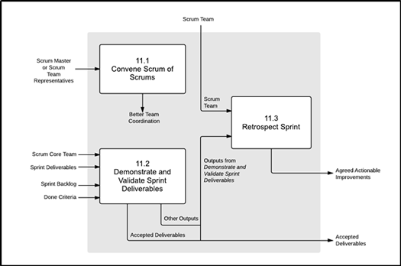
Following is the data flow diagram of the Review and Retrospect phase, broadly showing how different processes are connected to each other. For more details on different processes.

Slide 6
Release
The Release phase consists of following two processes.
Ship Deliverables - In this process, Accepted Deliverables are delivered or transitioned to the relevant stakeholders. A formal Working Deliverables Agreement documents the successful completion of the Sprint.
Retrospect Project - In this process, which completes the project, organizational stakeholders and Scrum Core Team members assemble to retrospect the project and identify, document, and internalize the lessons learned. Often, these lessons lead to the documentation of Agreed Actionable Improvements, to be implemented in future projects.

Slide 7
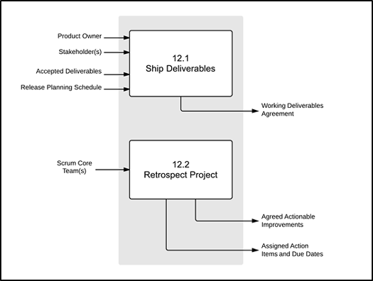
Following is the data flow diagram of the Release phase, broadly showing how different processes are connected to each other. For more details on different processes

